Slide 1
Data Storytelling Assignment
Name: JOSEPH HENCIL PETER
NRIC : S7967093F

Slide 2
Instructions
Congratulations, you made it this far!
In this course, you have learned the techniques of how to craft a narrative with the insights generated from your data and present them in a visually compelling way for your audience.
Now, it is time to show us that you are ready to take the step forward!
This assignment is based on a scenario, and the questions are based on the data provided in the file: Data Storytelling Assignment Data.xlsx
Please answer the questions based on the given information and submit this whole powerpoint document to the Data School Course Content area.

Slide 3
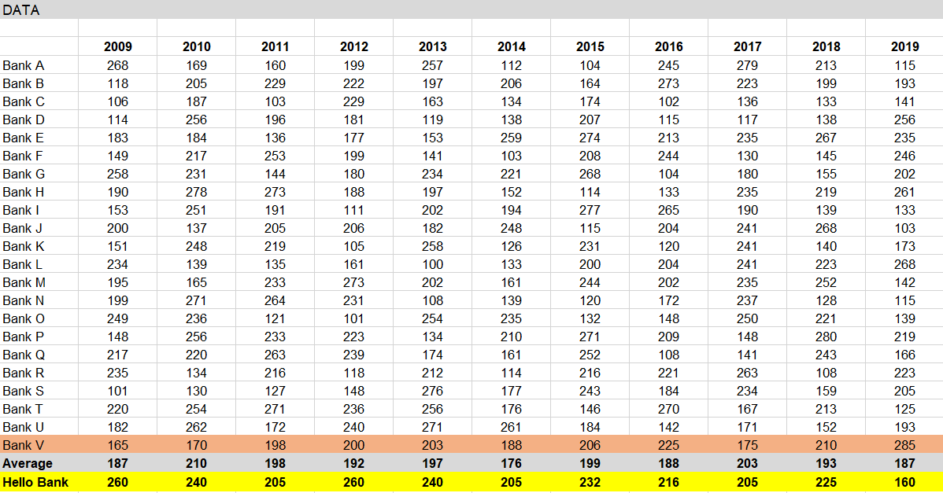
Scenario
You work in the marketing department in Hello Bank, and Bank V is one of your bank’s closest rival. One day, your manager, Tom, sent you an excel spreadsheet with a set of data asking you to generate some insights from it.

Slide 4
Question 1
Propose three questions that you would ask Tom to gain a better understanding of the context.
Answer:
What does the given numbers talk about?
Why latest/last year (2020) data are missing in the given excel sheet?
Who are the targeted audience?

Slide 5
Question 2
Tom wants to find out how your bank is faring against Bank V and recommends the use of a bubble chart. Explain if the bubble chart is suitable. If not, suggest and justify the use of another chart type.
Answer:
Bubble chart is used to display three dimensions data. E.g. social, economic and other relationships. So, Bubble char is NOT suitable.
We must use Line or Bar chart(s) to display the banks data.

Slide 6
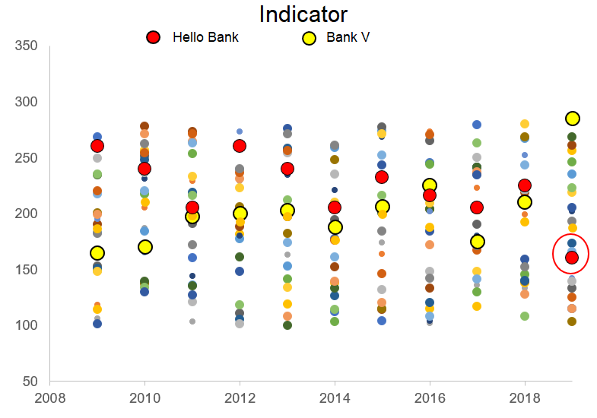
Question 3
Tom was growing impatient for your insights and did a dot plot. After some time, he revealed that although he finds that it is important for your bank to be better than Bank V, being above the industry average is of a higher priority to the Marketing Director, Lucy. Tom needs to give a presentation to Lucy in a weeks’ time, sharing any insights about the bank’s satisfaction scores.

Slide 7
Question 3 (cont.)
Tom further shared that the figures represent branch satisfaction. Provide two reasons why the chart Tom created does not effectively highlight the insight that Lucy is looking for.
Answer:
1. One main requirement is industry average which is not indicated in the chart.
2. Chart is confusing the audience and other bank names are not listed in the chart (except Hello Bank and Bank V).

Slide 8
Question 3 (cont.)
Design and create a revamped graph for Tom’s presentation (Hint: Declutter and Focus; Identify the right chart to use.)
Answer:

Slide 9
Question 4
A few days after you have completed your revamped graph, over lunch, Tom casually commented that your bank’s 2019 figures is calculated based on the average of the first 3 quarters satisfaction scores for the year. He is still waiting for the 4th quarter numbers from another colleague, but Tom believes that the scores will not differ much.
Explain how this might affect the interpretations of findings.

Slide 10
Question 4 (cont.)
Answer:
Though the 4th quarter data is missing, it will not affect the result (mostly) unless the fourth quarter result deviate too far from the previous score.
So there are three possible cases:
(i) If the fourth quarter score is close to the previous score, new graph will look same as the previous one.
(ii) If the fourth quarter score is below the previous score, new graph will show the poor performance.
(iii) Otherwise, fourth quarter score is above the previous score and new graph will show the better performance.

Slide 11
Question 4 (cont.)
Make modifications to your graph to reflect the limitations of data.
Answer: We can calculate the standard deviation (sample) for the Hello Bank's to adjust the score as the fourth quarter data is not available.
Below steps are followed:
(i) Calculate the Standard Deviation for Sample for Hello Bank.
(Calculate Sample Standard Deviation : 28.93684509 , Excel Formula : =STDEV.S(<Start Cell>:End Cell))
(ii) Add 28 with Hello Bank's existing score for the year 2019 (160 + 28 = 188 )
(iii) Subtract 28 from Hello Bank's existing score for the year 2019 (160 - 28 = 132 )
Draw line chart for (ii) and (iii) to see the performance difference.
Below slides shows the charts for (ii) and (iii)

Slide 12
Question 4 (cont.)

Slide 13
Question 4 (cont.)

Slide 14
Question 5
The private banking division head, Sally, approached Tom to share the banks’ satisfaction results with her. Tom is aware that among the list of banks, only 8 of them does private banking (Bank A to H). Previously when Tom gave a similar presentation to her, she mentioned that the graph has too little information and feels uncustomized. She wants to find out if the bank is performing better then the industry average. Describe how Tom should plan for the upcoming sharing.
Answer:
(i) Line or Bar chart can be used.
(ii) Re-calculate the Industry Average for the selected banks (if needed).
(iii) Only industry average and Hello Banks scores should be highlighted in the chart.
(iv) If the fourth quarter score is not given, follow the below steps to adjust the year 2019 score:
(a) Calculate the Standard Deviation for Sample for Hello Bank.
(b) Add the standard deviation value with Hello Bank's existing score for the year 2019
(c) Subtract the standard deviation value form Hello Bank's existing score for the year 2019
Draw line chart for (b) and (c) to see the performance difference.
(v) Give justification for the adjustment made.

Slide 15
Question 6
Tom has decided to appoint you to give the presentation to Paul, the Head of Finance, to approve the budget request for 2020 marketing campaign. With the next few slides, you are to simulate the presentation with the data and information provided earlier. Tom has also clearly stated the overall organization KPI, and have provided additional information:
Overall organization KPI: Satisfaction score to be above 250. You are to clearly indicate where each slide falls within the narrative arc – Beginning/Situation, Middle/Opportunity/Complication, End/Resolution.
To simulate your presentation, please fill in your script (what you would say in the real presentation) in the slide notes.

Slide 16
Question 6 (cont.)
Additional information: - 2009: a large marketing campaign that the industry called Hello Bank “The Bank for You” - 2010: reduced number of ATMs island wide in an attempt to discourage use of fiat currency - 2011: new ATM machine replacements had regular breakdowns causing long queues - 2012: introduced whole weekend banking service - 2013: launched new credit card with tiered rewards - 2014: delayed delivery of customer hardware token causing inability to log in to internet banking - 2015: increased marketing efforts to retain customers - 2016: high staff turnover rate impacting front-facing services - 2017: massive retraining efforts to increase staff productivity - 2018: launched family-friendly marketing theme - 2019: reduced marketing budget due to macroeconomic factors - 2019: Bank V Introduced mobile wallet and targeted the millennials. Led to significant growth in enrolment. Note: You may use the above information or create your own events. For the ending, there is no need to elaborate on the actual plan.

Slide 17
SITUATION
SITUATION (5)
The chart below shows the Comparison of Hello Banks score with Average Industry score and Competitor Bank V’s score:
Notes:
(FILL UP HOW YOU WILL NARRATE HERE)

Slide 18
SITUATION
Hello Bank's latest Score is Close to the Industry Average but behind the Competitor Bank V.
Hello Bank has performed well earlier. However, the Year 2019 shows poor score when comparing with Bank V.
It's been 10 years since the "The Bank for You" campaign organised by the Bank. Upon the "The Bank for You" campaign, Bank's score significantly increased.
Reduced marketing budget in the year 2019 could be the reason for the low score.
The expected target score to be above 250.
Tom believes marketing campaign will helps to improve the customer satisfaction and overall score.
Notes:
(FILL UP HOW YOU WILL NARRATE HERE)

Slide 19
COMPLICATION
Below chart shows the adjusted score (standard deviation added as 4th quarter data is missing) of Hello Bank, Bank V, Industry average and other banks score:
Notes:
(FILL UP HOW YOU WILL NARRATE HERE)

Slide 20
COMPLICATION
Marketing Campaign gives opportunity to convey the bank's benefits and attract new customers.
As Hello Bank's score is near the Industry Average, Major opportunities to attract predict customers.
As the Competitor Bank V doesn't conduct campaign for this year, Hello Bank can utilize the opportunity.
Other banks (like Bank V), introduces new features and proving the significant growth and its essential to introduce new features in Hello Bank upon hearing the feedback from the customers.
Hello Bank has shown very good score and adjusted score is just above the Industry average.
Notes:
(FILL UP HOW YOU WILL NARRATE HERE)

Slide 21
RESOLUTION
Marketing Campaign for the current year is essential to improve the Hello Bank's score.
As the expected score is 250 which is slightly below the competitor, Marketing Campaign can give good contribution for the additional score.
New Sales/Marketing executives must be hired with reasonable target to achieve the expected score.
New strategies will be implemented soon after the Campaign.
Notes:
(FILL UP HOW YOU WILL NARRATE HERE)

Slide 22
End of Data Storytelling Assignment

